Slide 1
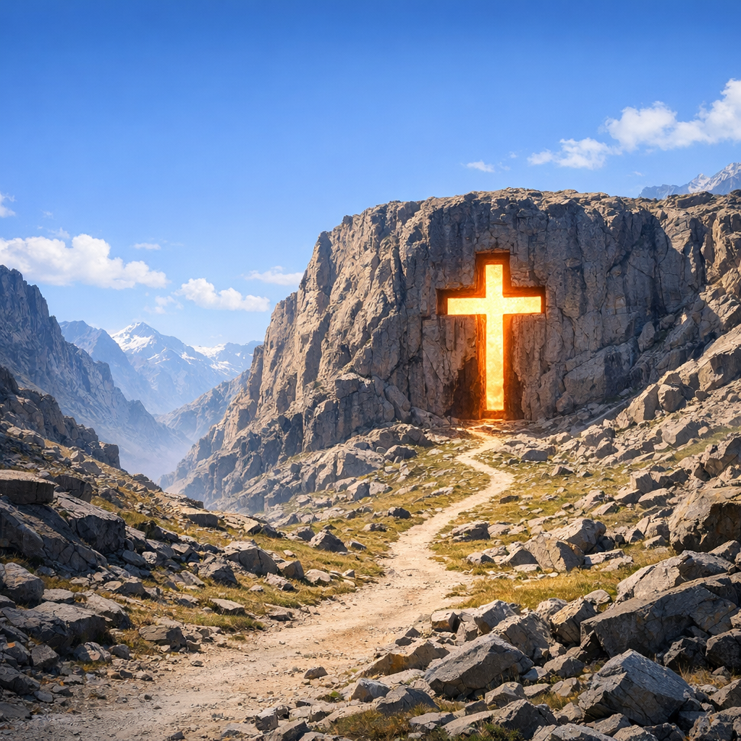
Forgiveness of Sin is Only in Christ’s Church According to What is Written in the Bible
Colossians 1:12-14
Notes:
Eddie Williams ~ June 14, 2020 (Eloy AM)
~ November 6, 2022 (Eloy AM)

Slide 2
Colossians 1:12-14 (ESV)
12 giving thanks to the Father, who has qualified you to share in the inheritance of the saints in light. 13 He has delivered us from the domain of darkness and transferred us to the kingdom of his beloved Son,

Slide 3
Colossians 1:12-14 (ESV)
14 in whom we have redemption, the forgiveness of sins.

Slide 4
Redemption:
Bought back with the blood of Jesus

Slide 5
Forgiveness of Sin Is Only in Christ’s Church
Three Points
Christ Has a Kingdom
Satan Has a Kingdom
Christ’s Kingdom is His Church, Satan’s Kingdom is the World

Slide 6
Point #1: Christ Has a Kingdom
Matthew 16:18-19 (KJV)
I Thessalonians 2:12 (NLT)
Colossians 1:13 (NLT)
I Corinthians 15:24 (NLT)

Slide 7
Matthew 16:18-19 (KJV)
18 And I say also unto thee, That thou art Peter, and upon this rock I will build my church; and the gates of hell shall not prevail against it.

Slide 8
Matthew 16:18-19 (KJV)
19 And I will give unto thee the keys of the kingdom of heaven: and whatsoever thou shalt bind on earth shall be bound in heaven: and whatsoever thou shalt loose on earth shall be loosed in heaven.

Slide 9
I Thessalonians 2:12 (NLT)
We pleaded with you, encouraged you, and urged you to live your lives in a way that God would consider worthy. For he called you to share in his Kingdom and glory.

Slide 10
Colossians 1:13 (NLT)
For he has rescued us from the kingdom of darkness and transferred us into the Kingdom of his dear Son,

Slide 11
I Corinthians 15:24 (NLT)
After that the end will come, when he will turn the Kingdom over to God the Father, having destroyed every ruler and authority and power.

Slide 12
Point #2: Satan Has a Kingdom
Matthew 12:25-26 (NLT)
II Corinthians 4:4 (KJV)
John 12:31 (AMP)

Slide 13
Matthew 12:25-26 (NLT)
²⁵ Jesus knew their thoughts and replied, “Any kingdom divided by civil war is doomed. A town or family splintered by feuding will fall apart.

Slide 14
Matthew 12:25-26 (NLT)
²⁶ And if Satan is casting out Satan, he is divided and fighting against himself. His own kingdom will not survive.

Slide 15
II Corinthians 4:4 (KJV)
In whom the god of this world hath blinded the minds of them which believe not, lest the light of the glorious gospel of Christ, who is the image of God, should shine unto them.

Slide 16
John 12:31 (AMP)
Now the judgment (crisis) of this world is coming on [sentence is now being passed on this world]. Now the ruler (evil genius, prince) of this world shall be cast out (expelled).

Slide 17
Point #3: Christ’s Kingdom is His Church, Satan’s Kingdom is the World
I Peter 2:9 (AMP)
Ephesians 2:2 (AMP)

Slide 18
I Peter 2:9 (AMP)
But you are a chosen race, a royal priesthood, a dedicated nation, [God’s] own purchased, special people,

Slide 19
I Peter 2:9 (AMP)
that you may set forth the wonderful deeds and display the virtues and perfections of Him Who called you out of darkness into His marvelous light.

Slide 20
Ephesians 2:2 (AMP)
In which at one time you walked [habitually]. You were following the course and fashion of this world [were under the sway of the tendency of this present age], following the prince of the power of the air.

Slide 21
Ephesians 2:2 (AMP)
[You were obedient to and under the control of] the [demon] spirit that still constantly works in the sons of disobedience [the careless, the rebellious, and the unbelieving, who go against the purposes of God].

Slide 22

…that Christ died for our sins according to the scriptures; And that he was buried, and that he rose again the third day according to the scriptures:

Slide 23
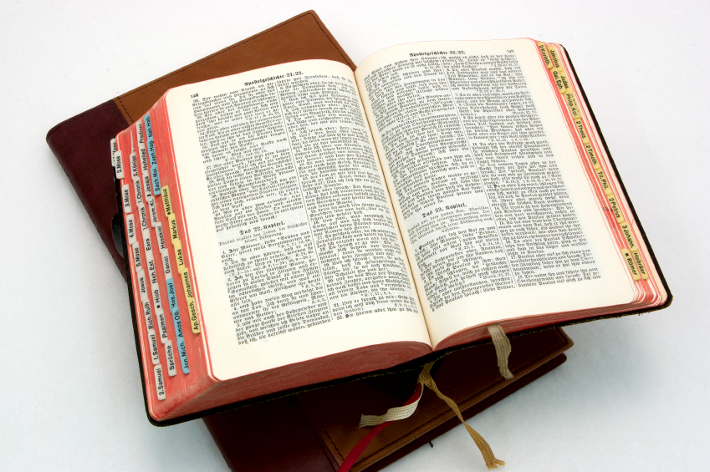
Hear: Romans 10:17
So then faith cometh by hearing, and hearing by the word of God.

Slide 24
Believe: Hebrews 11:6
But without faith it is impossible to please him: for he that cometh to God must believe that he is, and that he is a rewarder of them that diligently seek him.

Slide 25
Repent: Luke 13:3
I tell you, Nay: but, except ye repent, ye shall all likewise perish.

Slide 26
Confess: Matthew 10:32-33
32 Whosoever therefore shall confess me before men, him will I confess also before my Father which is in heaven.
33 But whosoever shall deny me before men, him will I also deny before my Father which is in heaven.

Slide 27
Baptize: Acts 22:16
And now why tarriest thou? arise, and be baptized, and wash away thy sins, calling on the name of the Lord.

